Slide 1


BSc Hons Computer Game Design and Development GDV4000 Introduction to Games Industry Practice
History of the Games Industry Part 2

Slide 2
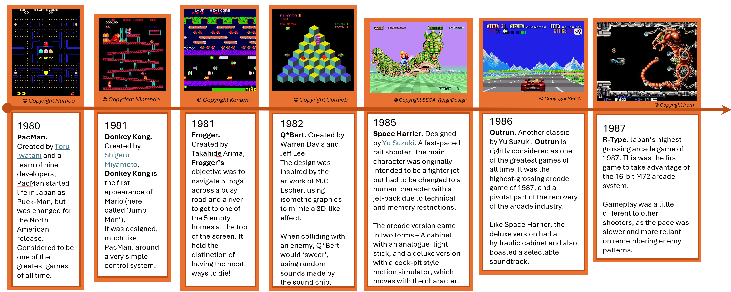
A Brief History of the Games Industry Part 2
Where we left off… The 1980’s
Home Computing and video game journalism really take off!

Slide 3
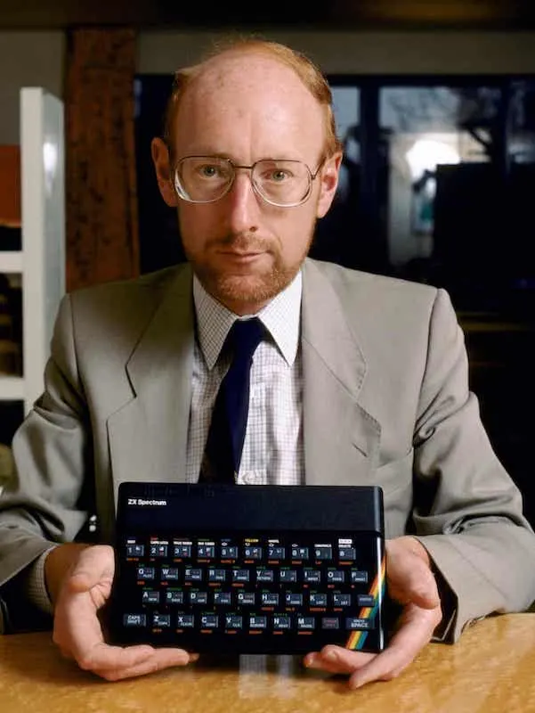
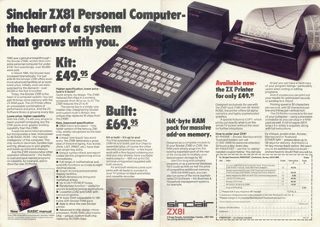
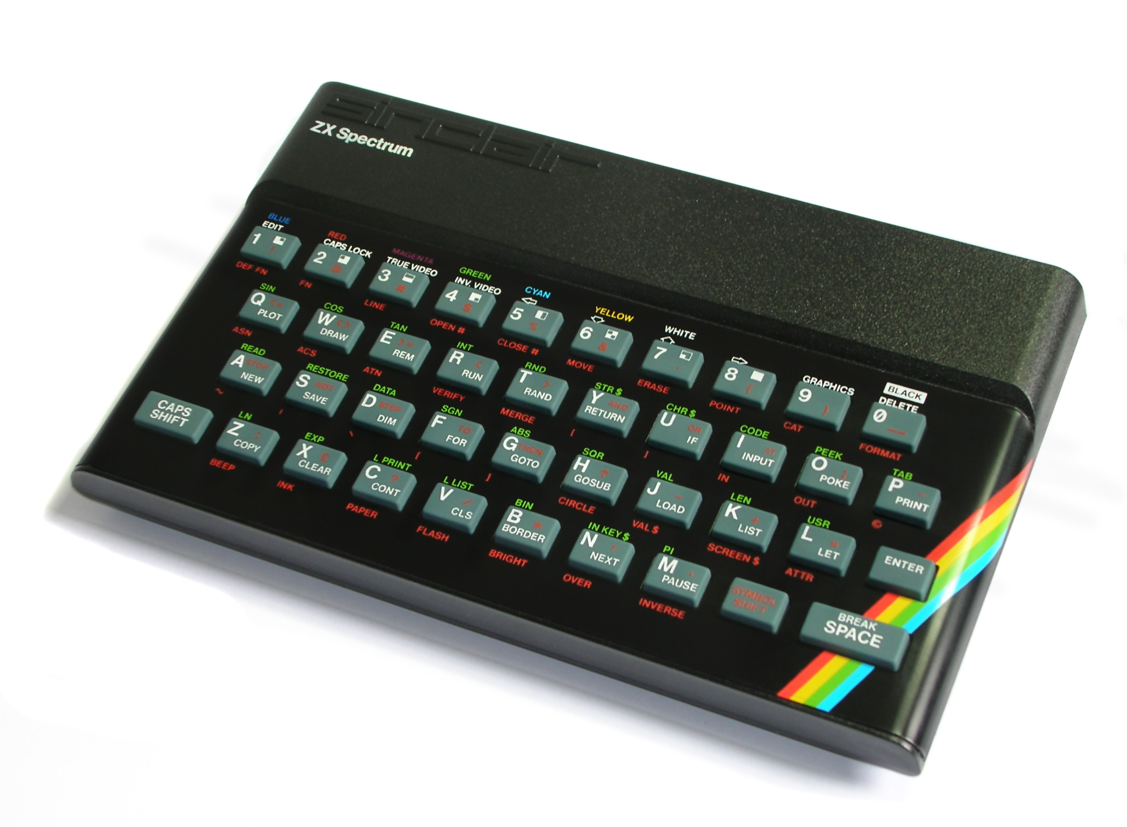
A Brief History of the Games Industry Part 2
The early 1980s saw a boom in home computing in the UK, largely thanks to British inventor and pioneer, Sir Clive Sinclair.
The ZX81 had only 1K of memory, a monochrome output and no sound, but it allowed home users to be able to learn programming at a low price of £69.99 or £49.99 if you purchased it in kit form! The ZX81 made Sinclair a millionaire and one of the UK’s highest-profile businessmen.
The ZX Spectrum 48K launched in 1982, with its eye-catching design and rubber keys. It now had colour and sound, and it inspired a generation of bedroom programmers. It is widely regarded as the most influential computer of the 1980s

Slide 4




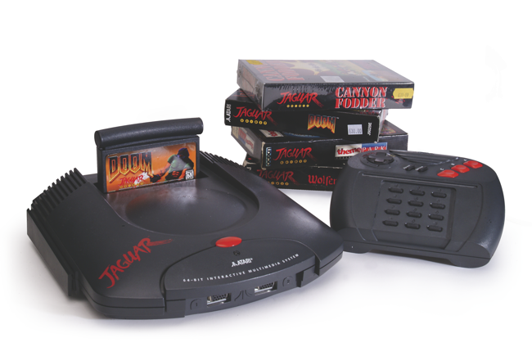

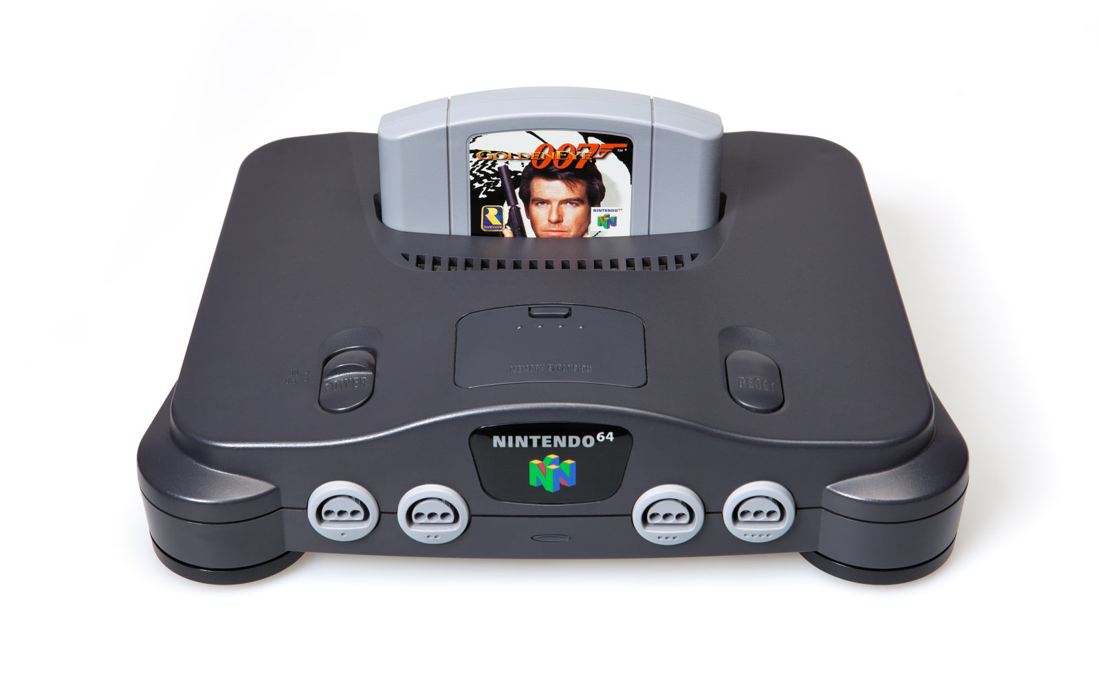
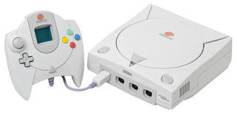
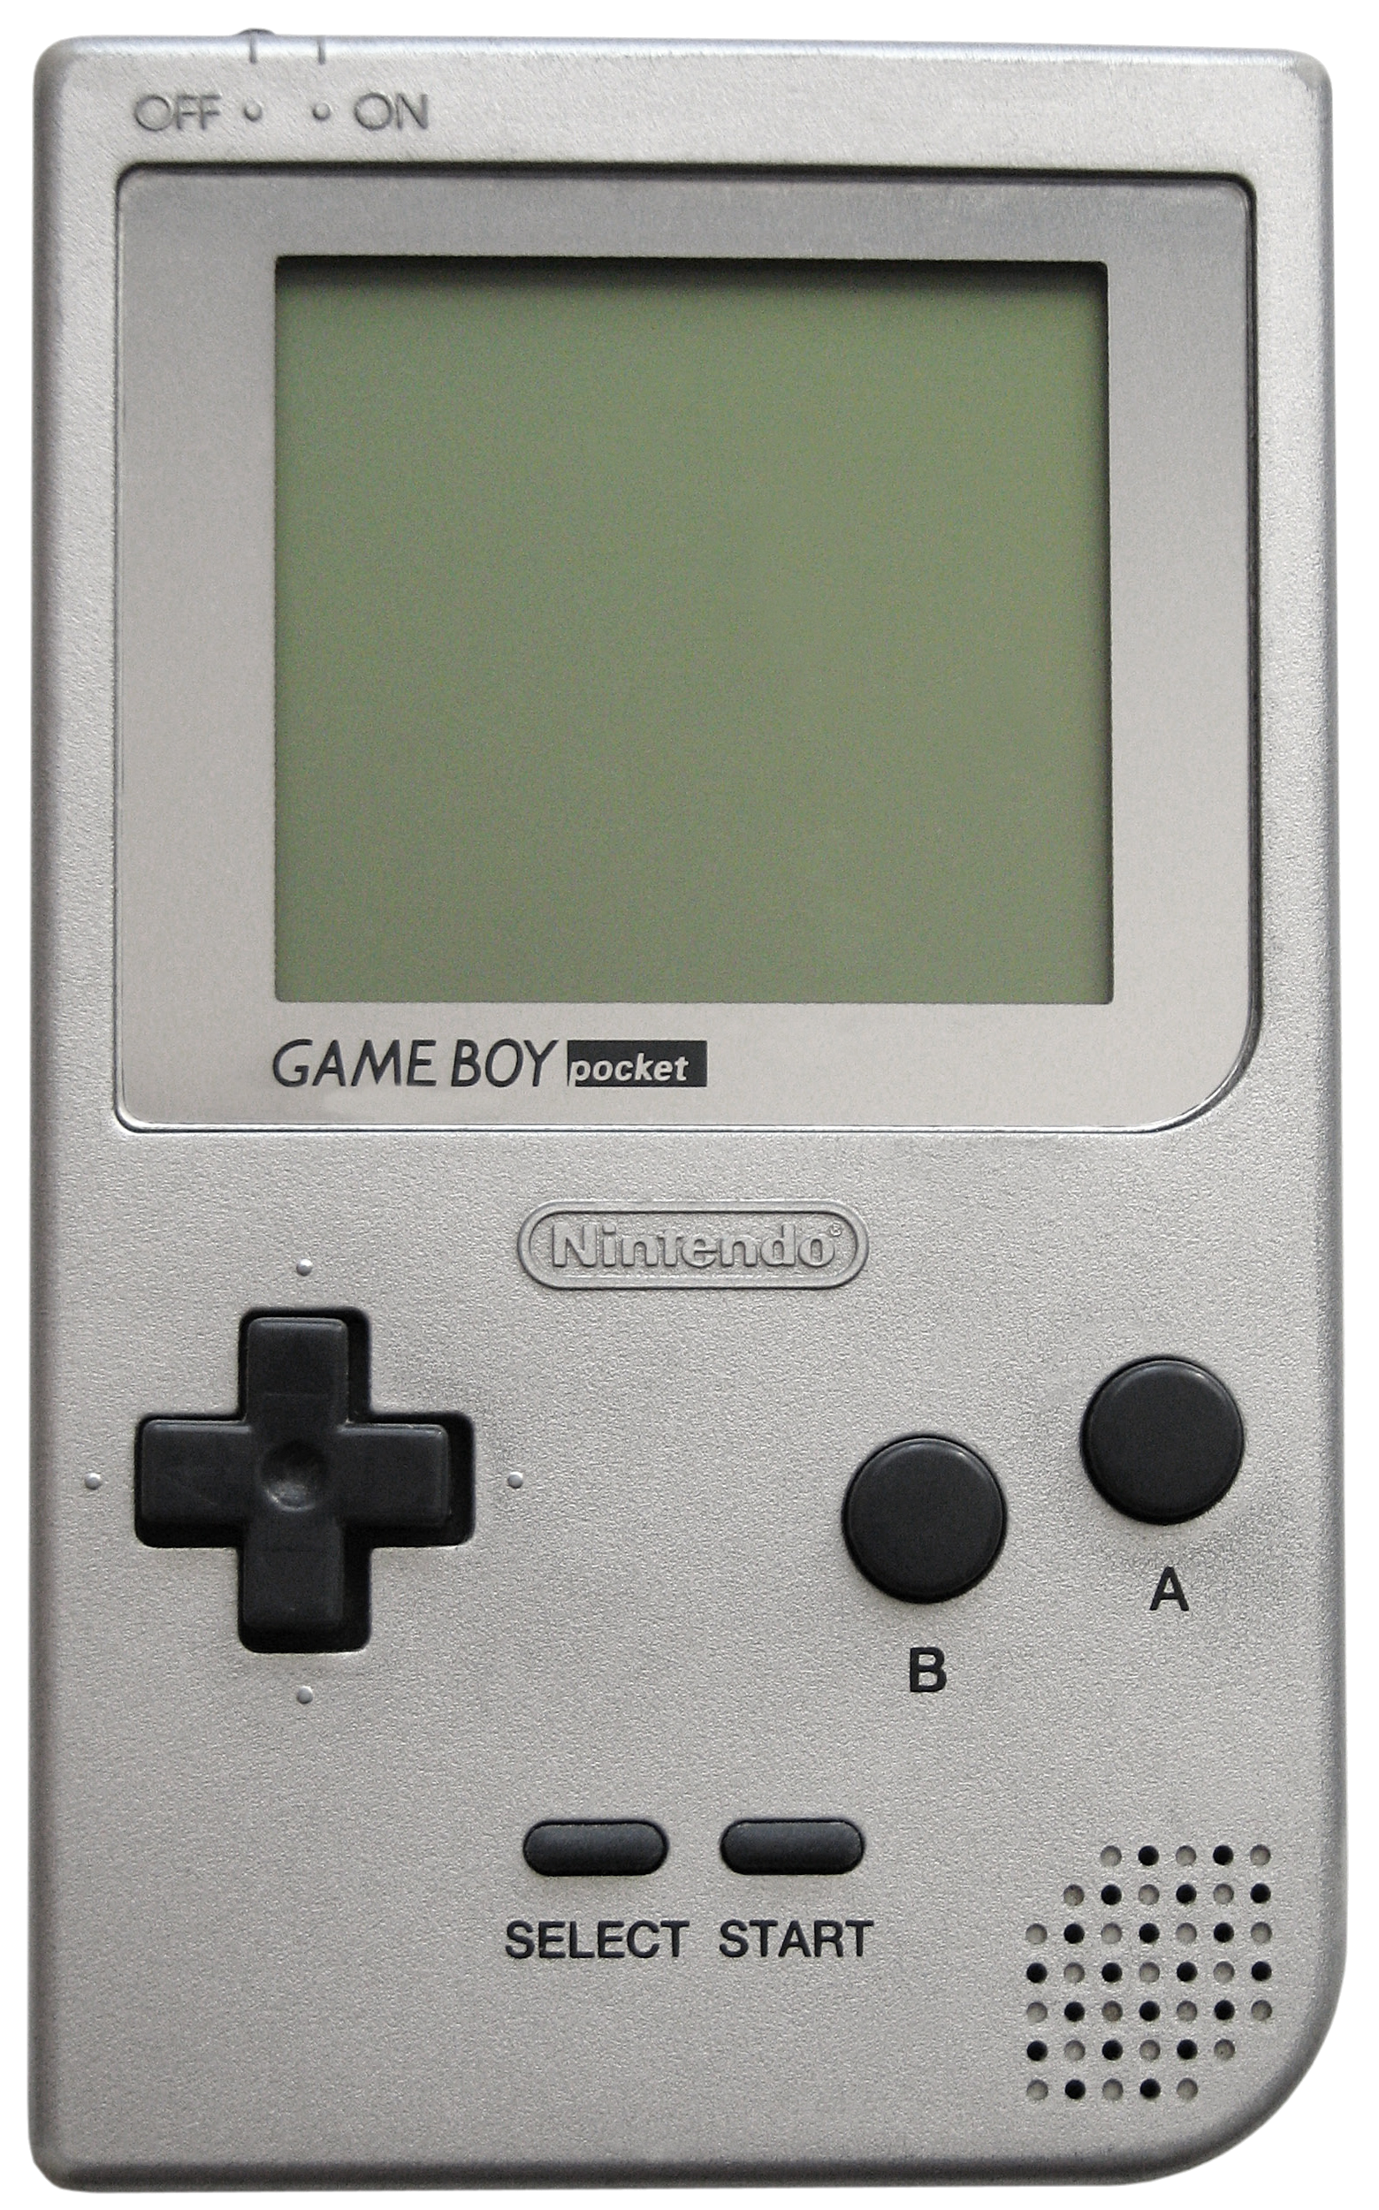
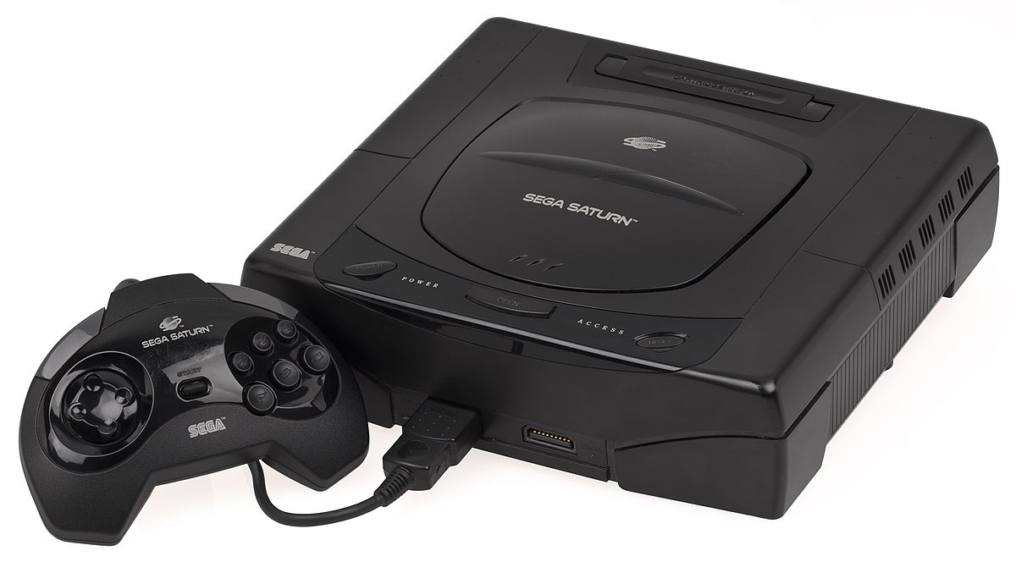


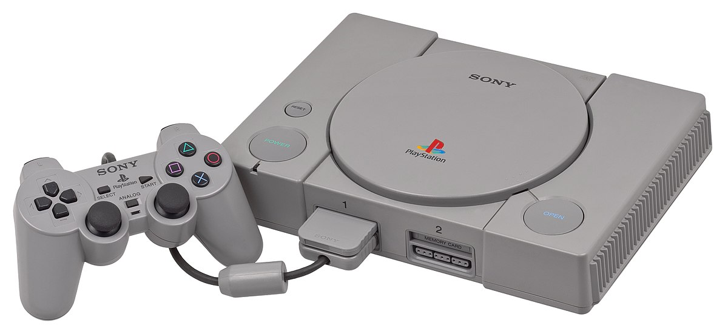
A Brief History of the Games Industry Part 2
1990s…
Direct3D (1996)
OpenGL 1.0. (1992)
NVidia inc. (1993)
3dfx Voodoo / Glide API (1996)
NVidia Riva 128 (1997)
SEGA 32X (1995)
Atari Jaguar (1994)
SEGA Saturn (1995)
N64 (1997)
SEGA Dreamcast (1999)
Gameboy Pocket (1996)
PlayStation (1995)
GoldenEye © Rare
MarioKart 64 © Nintendo

Slide 5
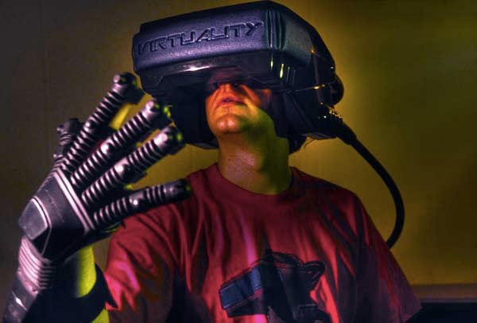
A Brief History of the Games Industry Part 2
Continued growth of GUIs
Development of dedicated 3D Graphics cards
CD Rom became the predominant method for data storage – Cartridges also still in use.
Emergence of the Internet and competitive gaming
More popular licensing of games
Consoles were the dominant platform during this period – Sega Megadrive, SNES, N64, PlayStation…
Early attempts at VR

Slide 6
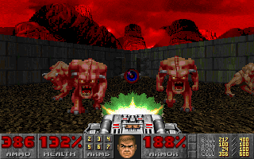


A Brief History of the Games Industry Part 2
1990s…
Doom © Id
Quake I © Id
Half Life © Valve
Doom (1993)
Quake I (1996)
Half Life (1998)

Slide 7

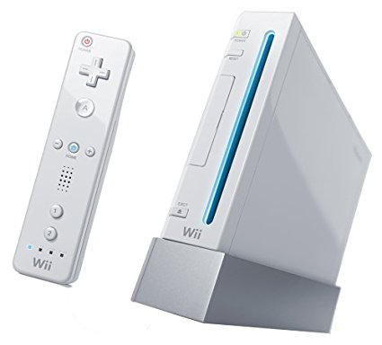
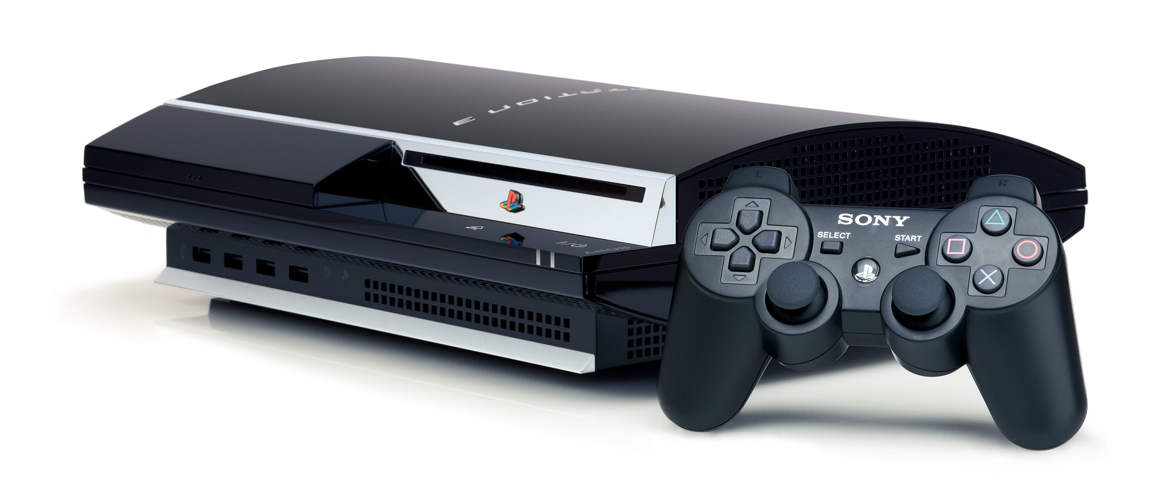
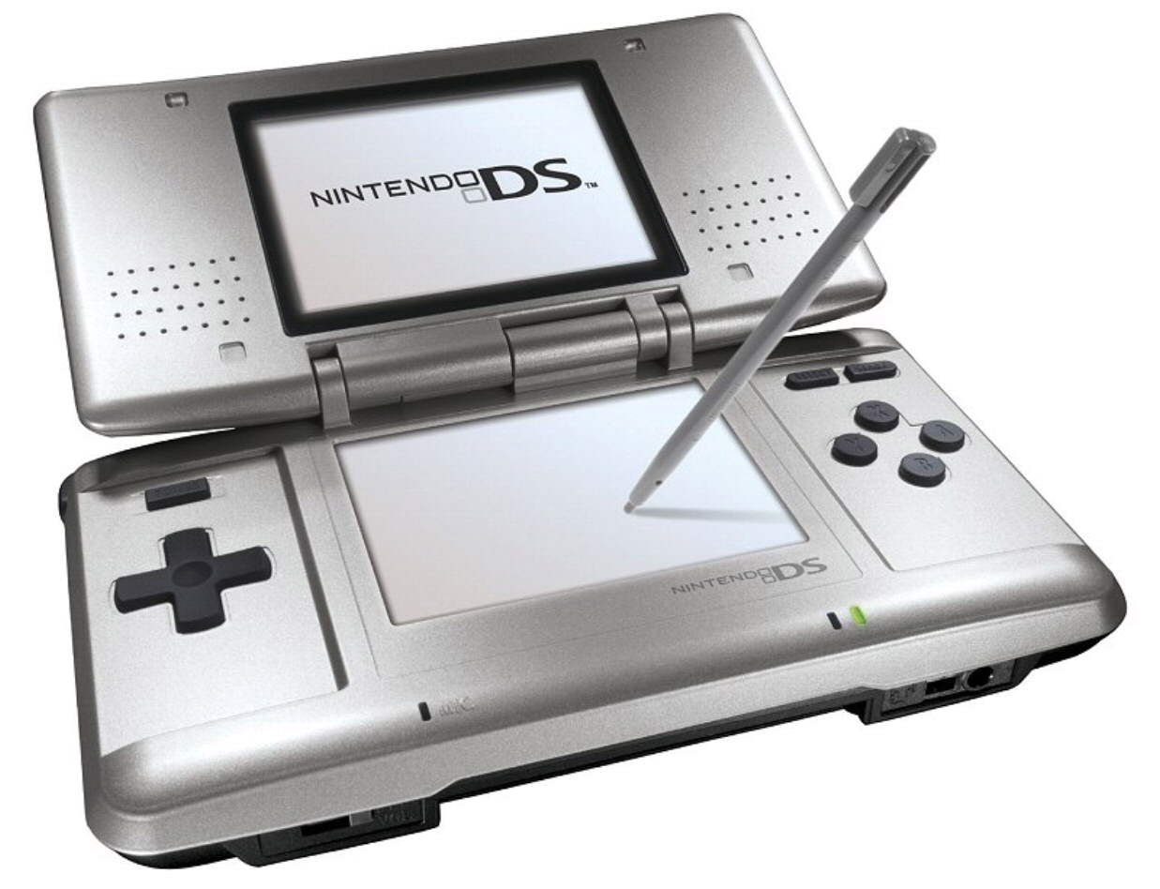
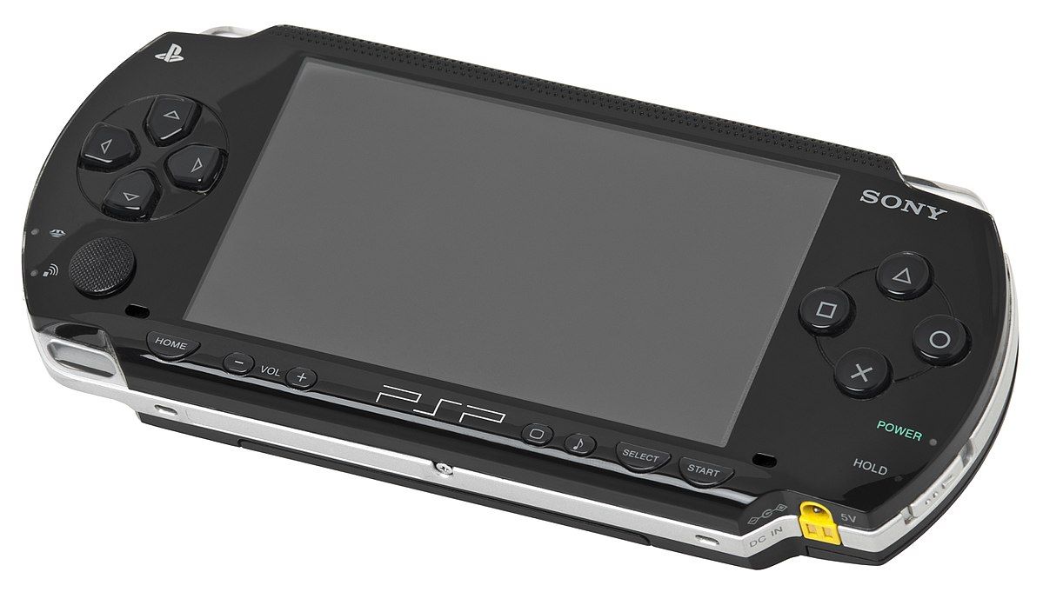
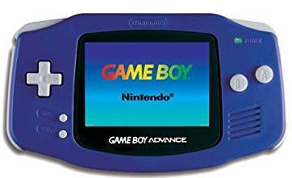
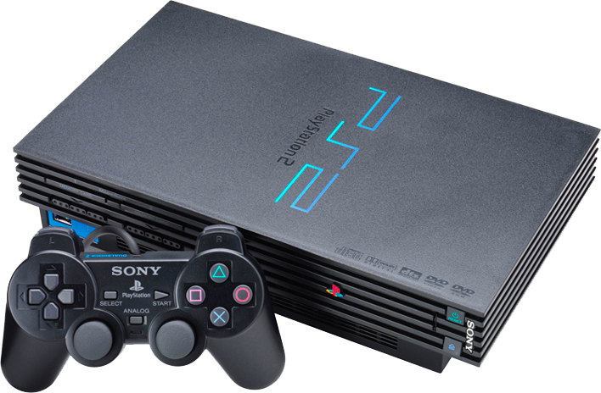
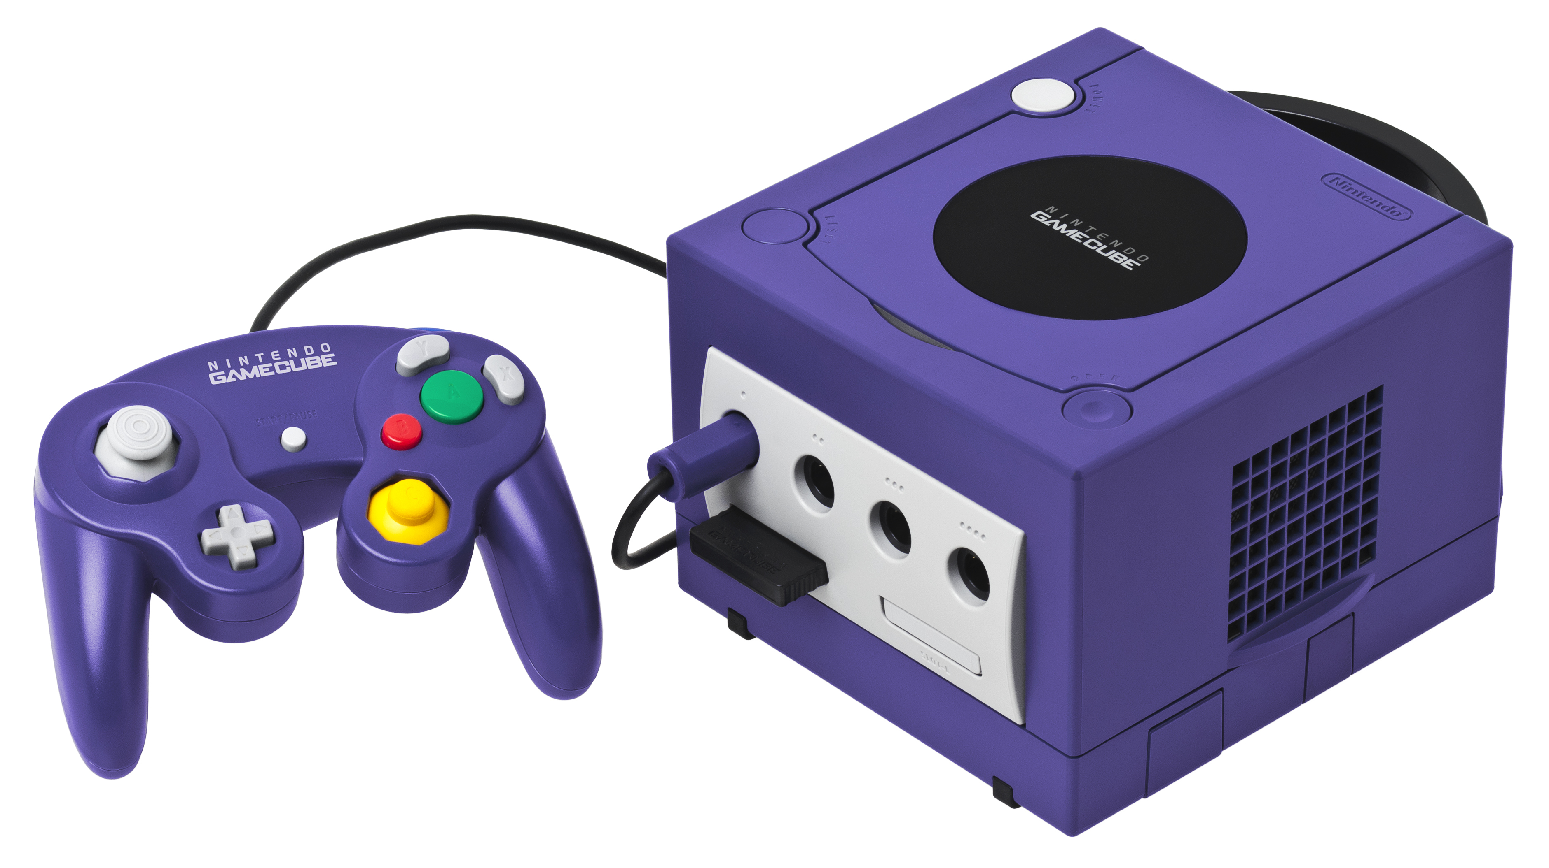

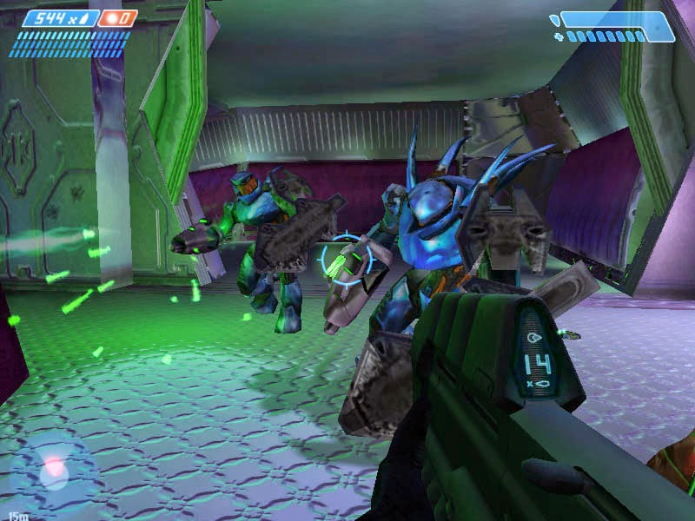


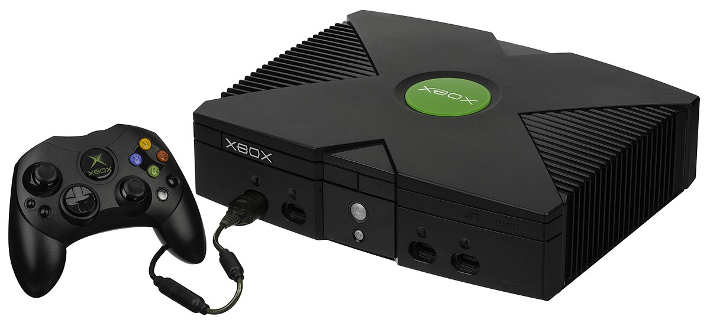
A Brief History of the Games Industry Part 2
2000s…
Nintendo DS (2005)
Sony PSP(2005)
Xbox 360 (2005)
Wii (2006)
PlayStation 3 (2007)
Gameboy Advance (2001)
Sony PlayStation 2 (2000)
Nintendo GameCube (2002)
Original iPhone (2007)
Halo © Microsoft / Bungie
Xbox (2002)
Ico (2001)

Slide 8
A Brief History of the Games Industry Part 2
2000s and beyond…
On PCs, Windows becomes the pre-dominant platform for gaming…
Windows XP (2001) DirectX 9 – 9c
Windows Vista (2006) DirectX 10
Windows 7 (2009) DirectX 11
Windows 8 (2012)
Windows 10 (2015) DirectX 12
Valve launch Steam in 2003, initially to provide a platform for patching Counter-Strike, and provide access to Valve releases.
Marked growth in smart phones and casual / mobile gaming, direct-to-market App stores towards the end of the decade.
Indie development continues to grow (Fez, Minecraft), with crowdfunding becoming more popular.

Slide 9
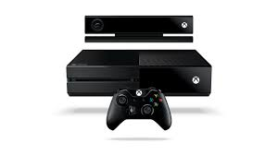
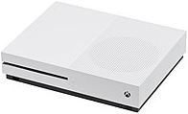
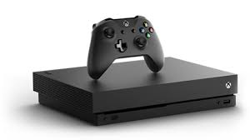
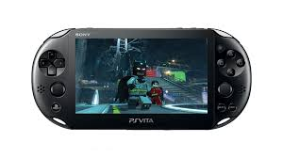
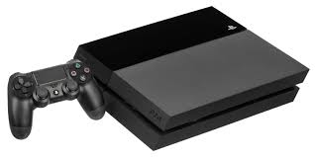
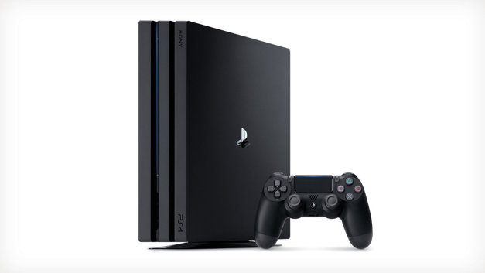

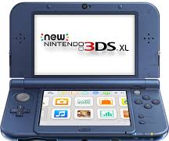
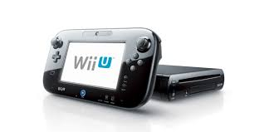
A Brief History of the Games Industry Part 2
2010s…
Xbox One X “Project Scorpio” (2017)
Xbox One (2013)
Xbox One S (2016)
Nintendo 3DS (2011)
PS Vita (2012)
Nintendo Switch (2017)
PlayStation 4 (2013)
Wii U (2012)
PlayStation 4 Pro (2016)
Market push to 4K / HDR

Slide 10
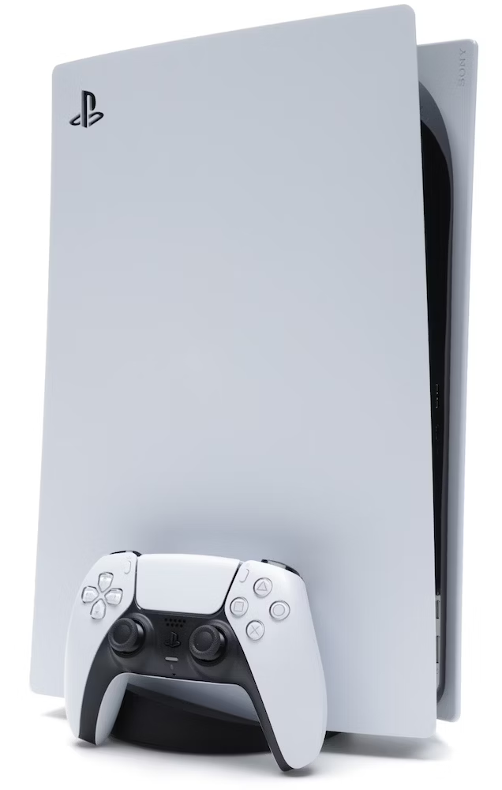
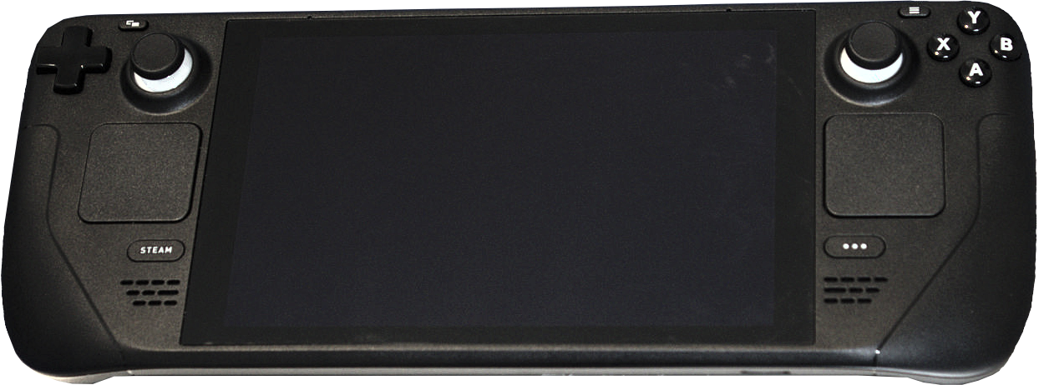

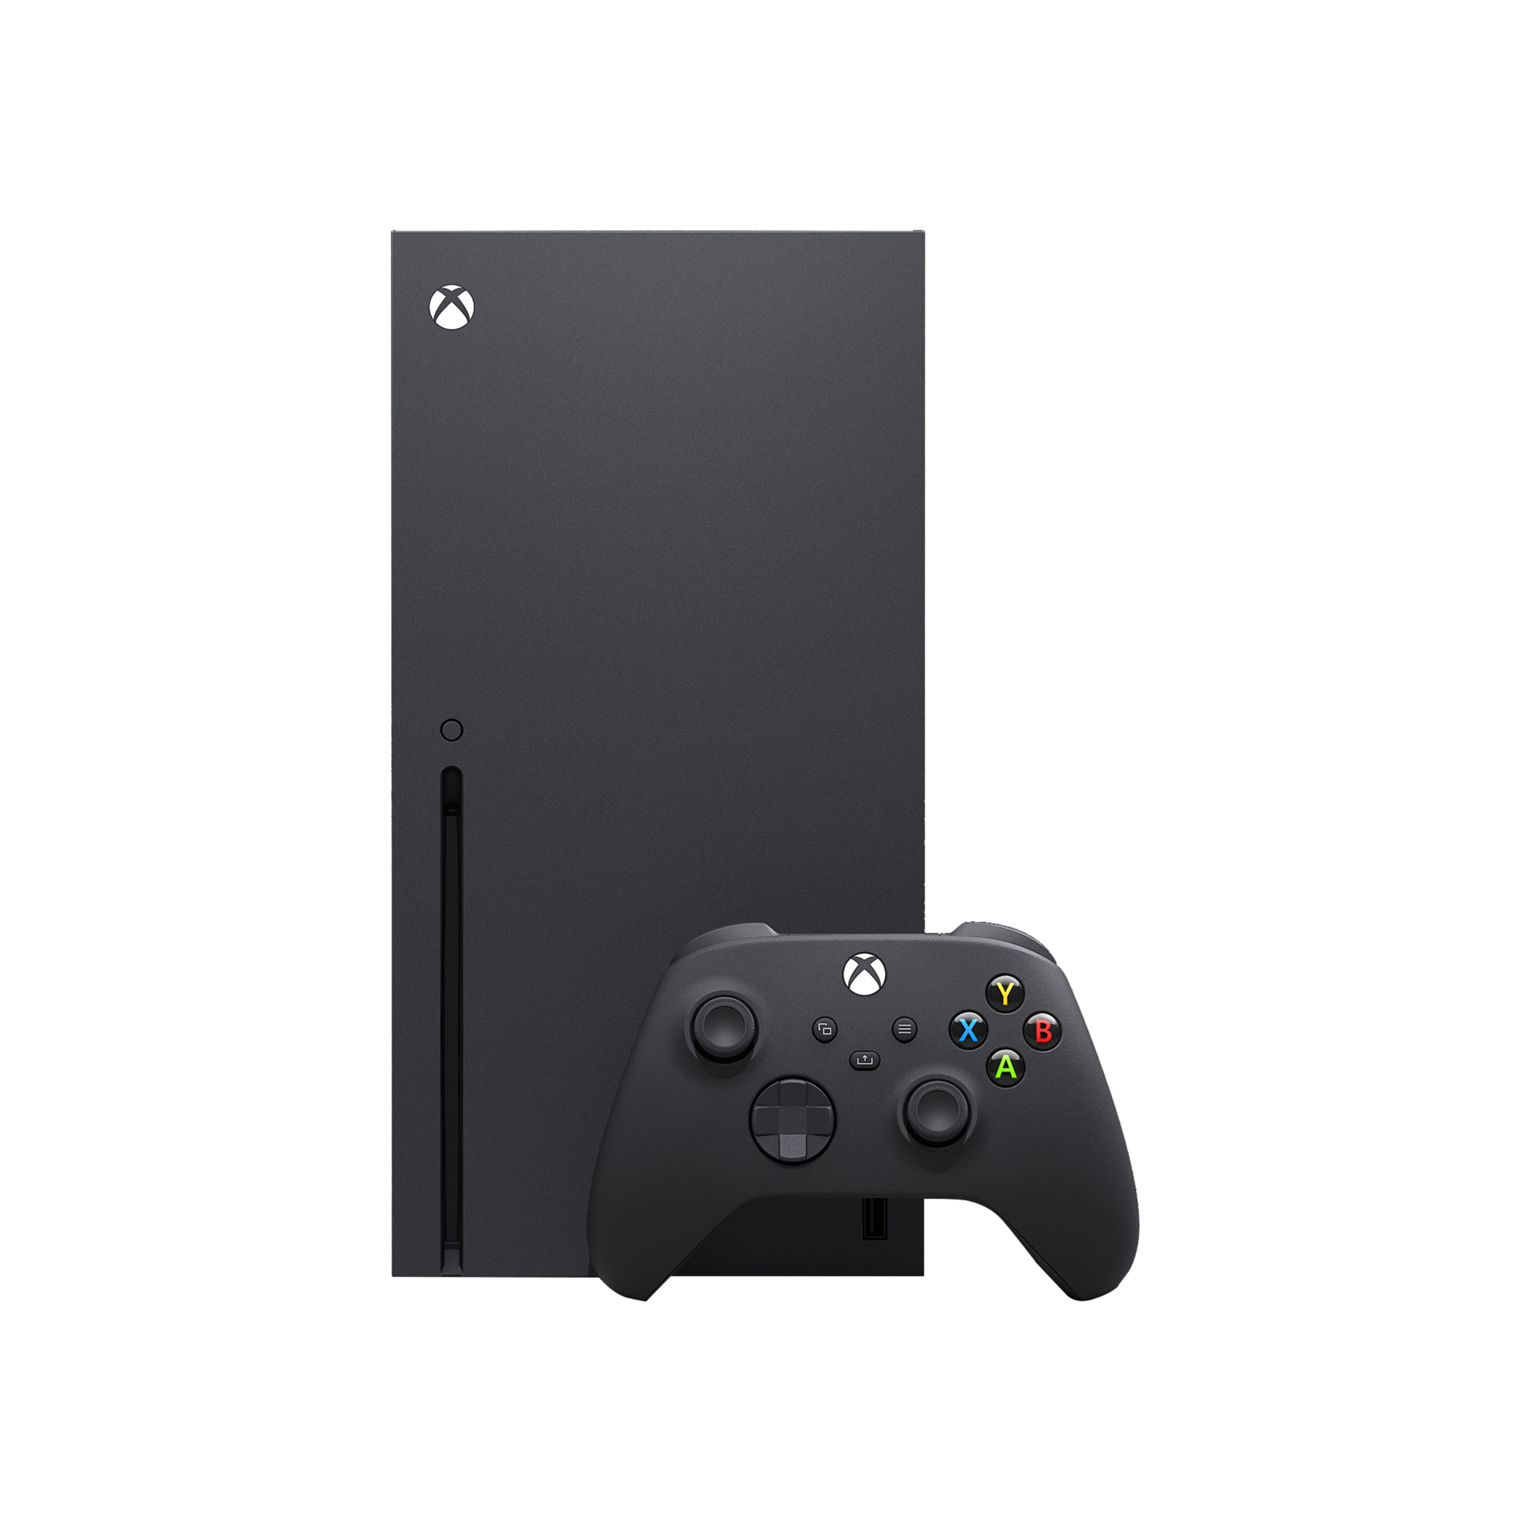

A Brief History of the Games Industry Part 2
2020s…
PlayStation 5 (2020)
Valve Steam Deck (2022)
New Nintendo Switch (20XX)
Xbox Series X (2020)
Xbox Series S (2020)
Market push to 4K / HDR

